Slide 1

PINNs
for turbulence
prediction
D E E P L E A R N I N G S E M E S T E R P R O J E C T
P R E S E N T B Y -
R O H A N S H A R M A M 2 5 0 0 1 4 C S
M .T e c h i n A I & M L
Supervised under D R . B A M B A H A D U R S I N H A

Slide 2
P R O B L E M S T A T E M E N T S
Turbulent fluid flow is governed by nonlinear partial differential equations (PDEs), specifically the Navier–Stokes equations.
Traditional numerical methods (CFD: Finite Difference / Finite Element / Spectral Methods):
Requires fine meshes
Are computationally expensive
Struggles with high dimensional and real time predictions
There is need for
A data efficient
Mesh free
Physics-consistent approach

Slide 3
I N T R O D U C T I O N
Deep learning
Governing physics laws (PDEs)
Physics Informed Neural Networks

Slide 4
I N T R O D U C T I O N
Deep learning
Governing physics laws (PDEs)
Physics Informed Neural Networks
Instead of learning from the labelled data , PINNs enforces Navier Stokes equation as loss functions.
Advantages
No CFD snapshots are needed
Mesh free in formulation and evaluated at any point in the domain
Works well for the inverse and forwards

Slide 5
I N T R O D U C T I O N
Deep learning
Governing physics laws (PDEs)
Physics Informed Neural Networks
Instead of learning from the labelled data , PINNs enforces Navier Stokes equation as loss functions.
Advantages
No need for large labelled datasets
Continous solution over the domain
Works well for the inverse and forwards
We tried to solve a 2D kolmogorov flow problem
Velocity field
(u,v)
Pressure
(p)
Vorticity,
speed

Slide 6
01.
02.
P R O J E C T
W O R K F L O W
A R C H I T E C T U R E
03.
04.
05.
06.
07.
08.
09.
Installing libraries and loading dependancies
Initialising PINNs
Sampling COLLOCATION points (x,y)
Forward Pass —> predict (u, v, p)
Compute derivatives (Auto Diff)
calc. Loss - PDE residual , - Boundary Loss
Training PINN
Flow field prediction
Visualization

Slide 7
Governing physics
u(∂u/∂x) + v(∂u/∂y) = −(∂p/∂x) + 1/Re( ∂²u/∂x² + ∂²u/∂y² )
u(∂v/∂x) + v(∂v/∂y) = −(∂p/∂y) + 1/Re( ∂²v/∂x2 + ∂²u/∂y² )
u_{x}+ v_{y}= 0
uu_{x}​+ vu_{y​}= −p_{x​}+ 1/Re ​(u_{xx​}+u_{yy}​)
uv_{x}​+vv_{y​}= −p_{y​}+ 1/Re ​(v_{xx​}+v_{yy}​)
Methodology

Slide 8
PINN architecture
Data matching
(sparse measurement)
Loss_{data} = || u_{pred} - u_{meas} ||²
Deep neural network
(tanh + linear)
Compute PDE
PDE residual
Total Loss Function
x, y
Boundary & Initial Conditions
Loss_{BC} = || B [u] - b ||²
Methodology
Backward propagation and weight updation

Slide 9
training
Loss func.
Optimiser : adam
Initial learning rate : 0.001
Epochs : 15,000
StepL scheduler halves learning rate every 5000 epochs
Gradient clipping with max norm 1.0 for stabilty
L (ፀ) = λ_{d} * Loss_{data} + λ_{p}* LossPDE + λ_{b}* Loss_{BC}
Methodology

Slide 10
u(x,y)
v(x,y)
p(x,y)
Compute PDE residuals:
- Continuity
- x-momentum
- y-momentum
Input
(x,y)
PINNs
Automated differentiation
Predicted field
Post-processing:
velocity magnitude, streamlines, pressure, vorticity, GIF
Backpropagation + Adam optimizer + LR scheduler
Apply boundary condition on walls
Trained model
Total Loss

Slide 11
V I S U A L I S A T I O N

Slide 12
V I S U A L I S A T I O N
Vorticity highlights strong shear near walls and recirculation zones.

Slide 13
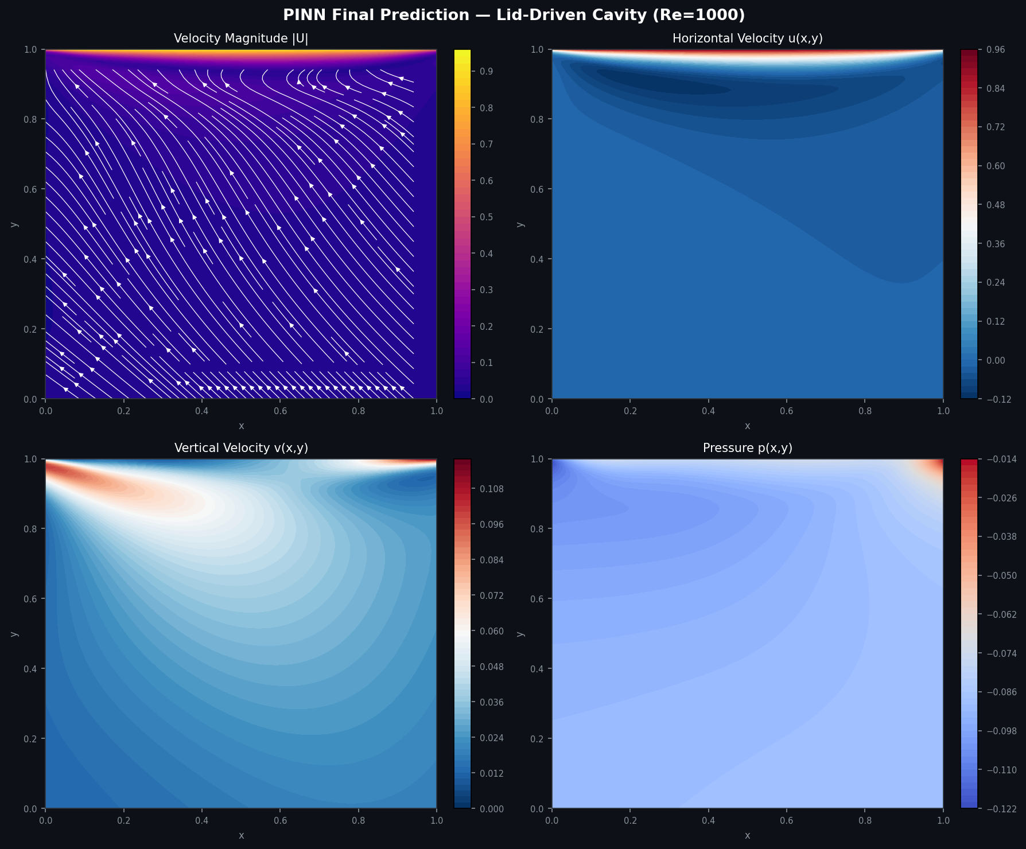
V I S U A L I S A T I O N
Pressure field captures spatial pressure variation coupled to the velocity solution.

Slide 14
Losses during Epochs
At epoch 500, total loss was about 1.67×10⁻¹
By epoch 14,500, total loss dropped to about 1.98×10⁻².
At epoch 15,000, total loss was about 4.84×10⁻²,
showing some fluctuation near the end

Slide 15
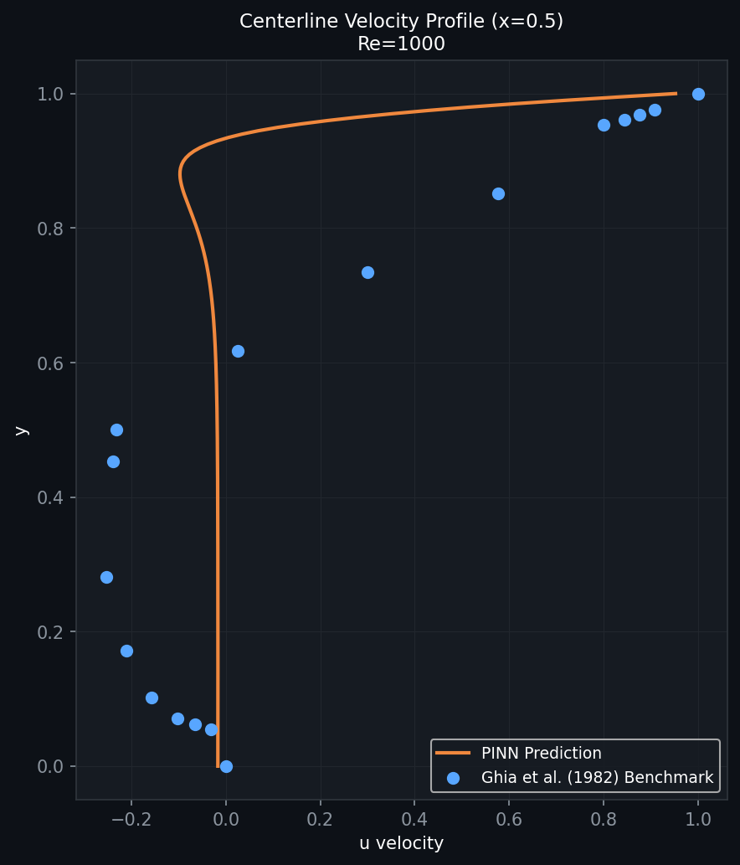
V I S U A L I S A T I O N
The fluctuating late-stage loss suggests optimization difficulty, which is common in PINNs for stiff or high-Reynolds-number flows.

Slide 16
GAPS & LIMITATIONS.
3D restriction
Reynolds number
The project solves a steady 2D cavity case only, so it does not capture full transient or 3D turbulence behavior.
Reynolds number 1000 is challenging for PINNs; high-Re flows are known to cause local minima, stagnation, and poor recovery of sharp boundary-layer structures
Benchmark Reference
Pressure Boundary
No benchmark comparison with Ghia et al. centerline velocity profiles or CFD reference data is included in the notebook, so quantitative accuracy is not fully validated.
Pressure boundary treatment is implicit, which may affect robustness depending on formulation

Slide 17
F U T U R E S C O P E
Compare predictions with benchmark cavity-flow profiles from Ghia et al. for quantitative validation.
Test multiple Reynolds numbers such as 100, 400, and 1000.
Explore improved PINN strategies such as adaptive loss weighting, domain decomposition, Fourier features, or re-initialization methods for stiff flows.
Extend from steady 2D flow to transient or 3D flow problems.
Extend to 3D or more complex geometries
Combine physics-based learning with sparse real or CFD data for higher accuracy
future

Slide 18
THANK
YOU.
Do you have any
questions ??

